Slide 1
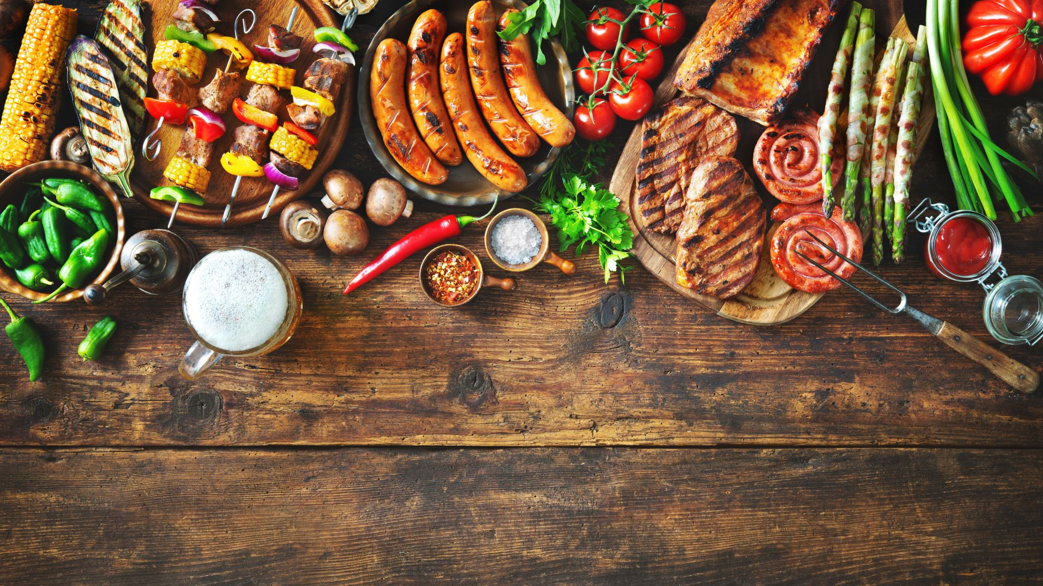
FARM MANAGEMENT SYSTEM

Slide 2
TABLE OF CONTENTS
1.Problem Statement………………………………………………………...........3
2.Existing System……………………………………………………………….........4
3.Drawbacks of Existing System……………………………………………..5
4.Proposed system with design…………………………………………………6
5.Implementation details of each module……………………………….9
6.Output……………………………………………………………………………………….29
7.Conclusion…………………………………………………………………………………….30

Slide 3
PROBLEM STATEMENT
Farm Management System is to help farmers by providing all kinds agriculture related information. Farm Management System is platform which helps farmers to give best-practice farming process. It helps farmers to improve their productivity and profitability. This enables farmers to sell their products, consumers to buy products and farming practices. It also help farmers to seek help from authorities and they can provide help to farmers .The name Farm Management System indicates Intelligent Agriculture.

Slide 4
EXISTING SYSTEM
The Existing system focuses mainly on farmers, enabling only to sell their harvest and to buy the necessary accessories.
This helps in providing a wider market and helping them to not restrict themselves to the local market. This enables wholesalers and retailers to expand their business.

Slide 5
DRAWBACKS OF EXSISTING SYSTEM
The existing system is complex and hard for the farmers to understand who don’t have enough knowledge about operating a PC.
It mainly focuses on famers, and not caring about the customers.
It cannot be accessed in remote locations.

Slide 6
PROPOSED SYSTEM WITH DESIGN
To develop a project, solving agricultural farming related applications for farmers, consumers and management. The project has this following extended features:
This system has 3 types of users:
FARMERS
CUSTOMER
MANAGEMENT

Slide 7
PROPOSED SYSTEM WITH DESIGN
The farmers are able to:
1.help , 2.sell crops, 3.farming practices.
The customer can search the name of the crop, the cost per quintal and quintals available accordingly to their requirement.
Customers can buy products without the involvement of third parties.

Slide 8
PROPOSED SYSTEM WITH DESIGN
For farmers to improve security, the platform is available with secured login.
Farmers can seek help from authorities about their problems.
Management can provide help to farmer and management also stores fund for farmers .

Slide 9

DESIGN
USERS
FARMER
CUSTOMER
MANAGEMENT
LOGIN
1.FARMING GUIDANCE
2.SELL CROPS
3.HELP
BUY HARVESTED CROPS ACCORDING TO YOUR REQUIREMENT
1.SUPPORT
2.FUNDS

Slide 10
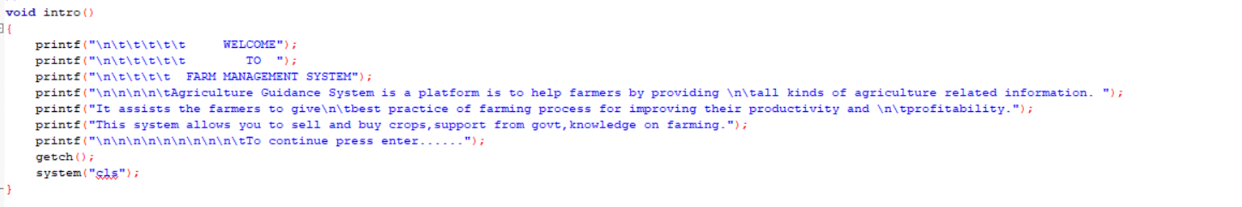
IMPLEMENTATION DETAILS OF EACH MODULE
The code starts with an intro which then gets cleared by pressing enter……..

Slide 11
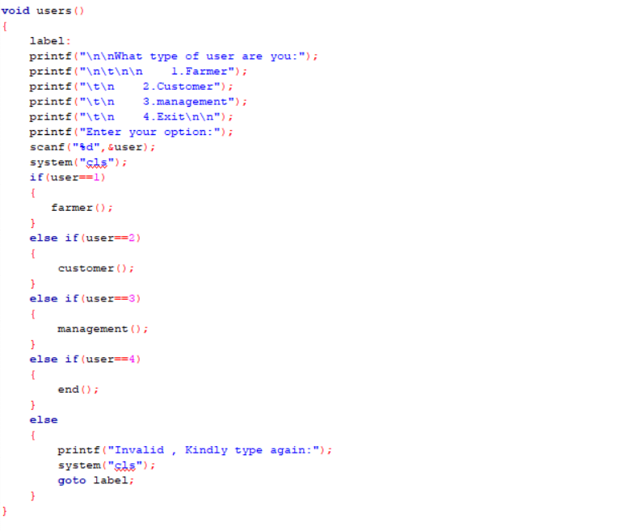
IMPLEMENTATION DETAILS OF EACH MODULE
Now the function defined for the type of users:
1.Farmer
2.Customer
3.Management
4.Exit.

Slide 12
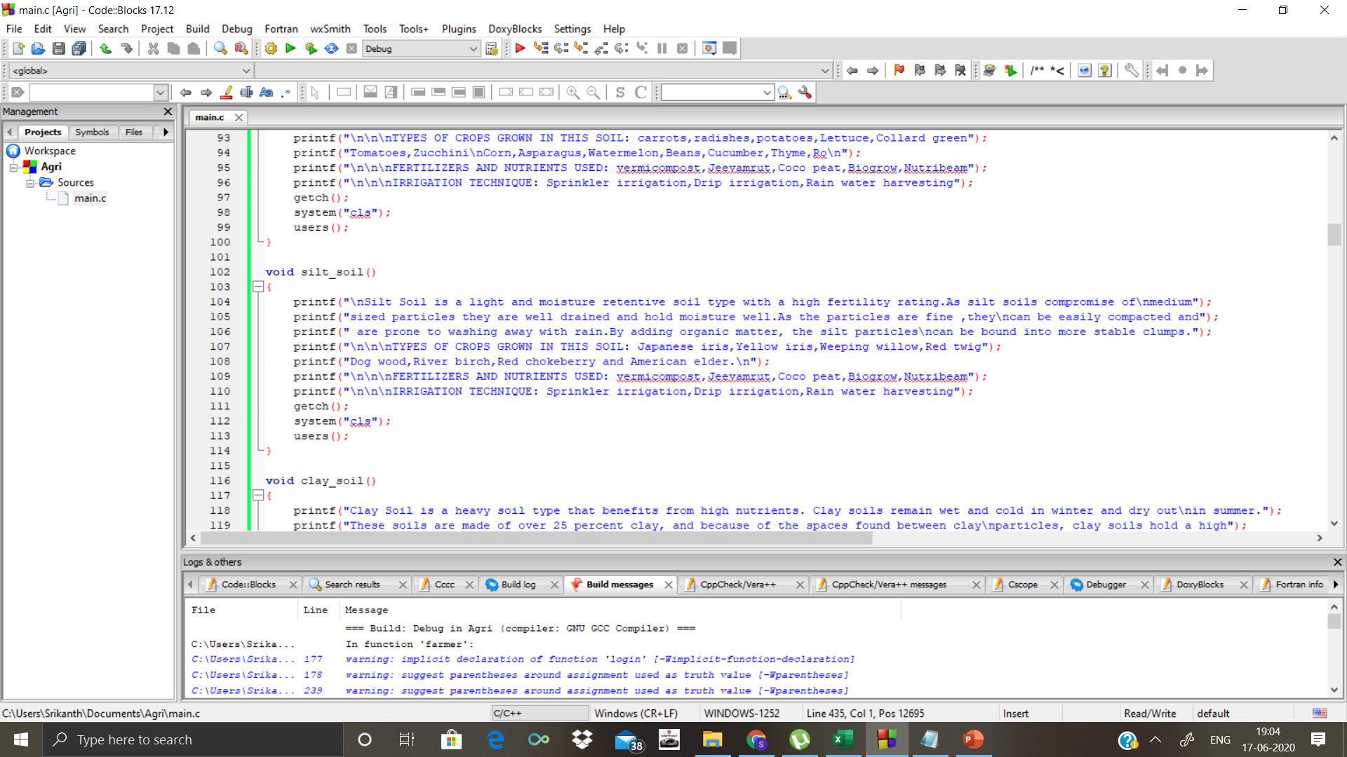
IMPLEMENTATION DETAILS OF EACH MODULE
A total of 6 Functions defined for type of soils. Based on the data now the program recommends the type of crops that can be grown, fertiliser, harvesting technique etc……

Slide 13
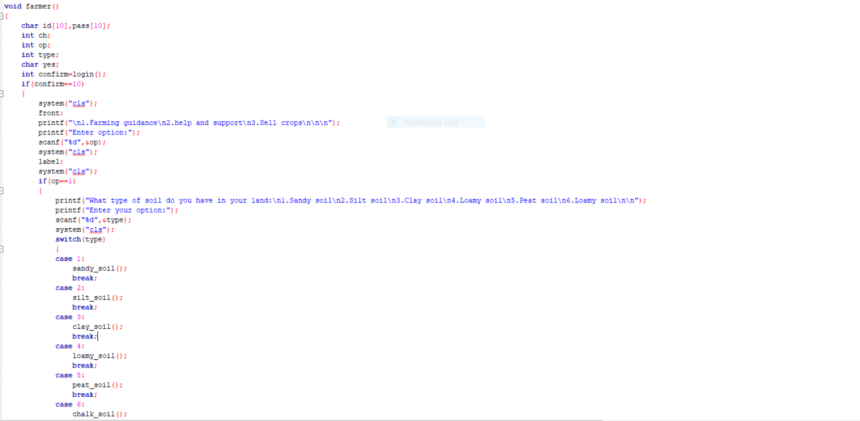
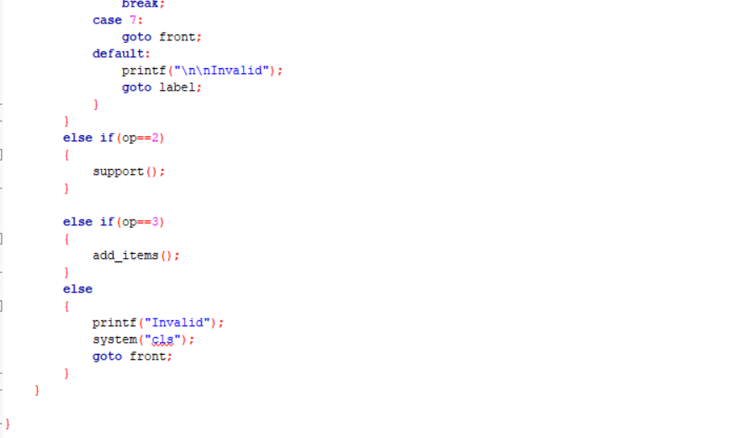
IMPLEMENTATION DETAILS OF EACH MODULE
Function for farmer:

Slide 14
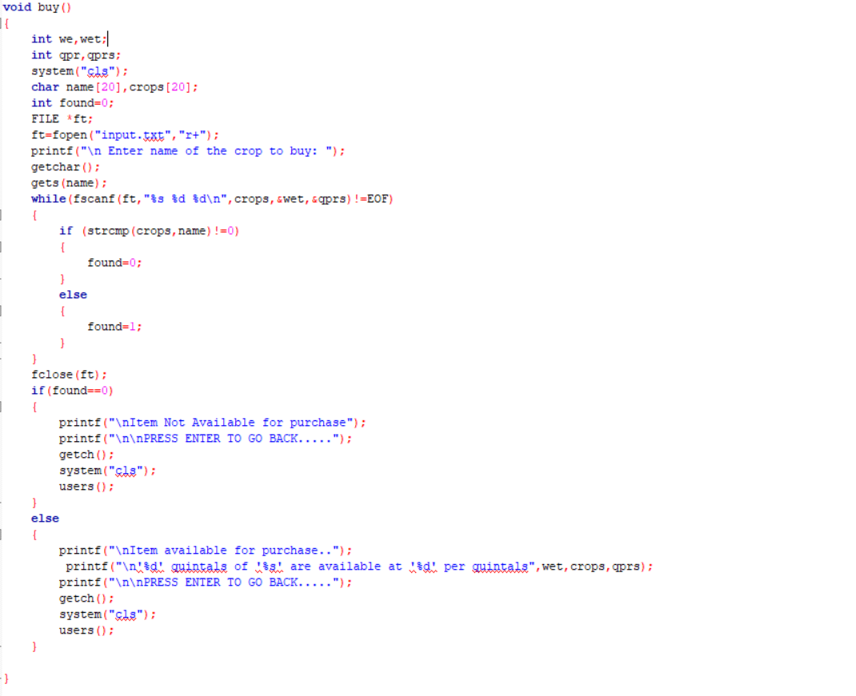
IMPLEMENTATION DETAILS OF EACH MODULE
Function for Customer:

Slide 15
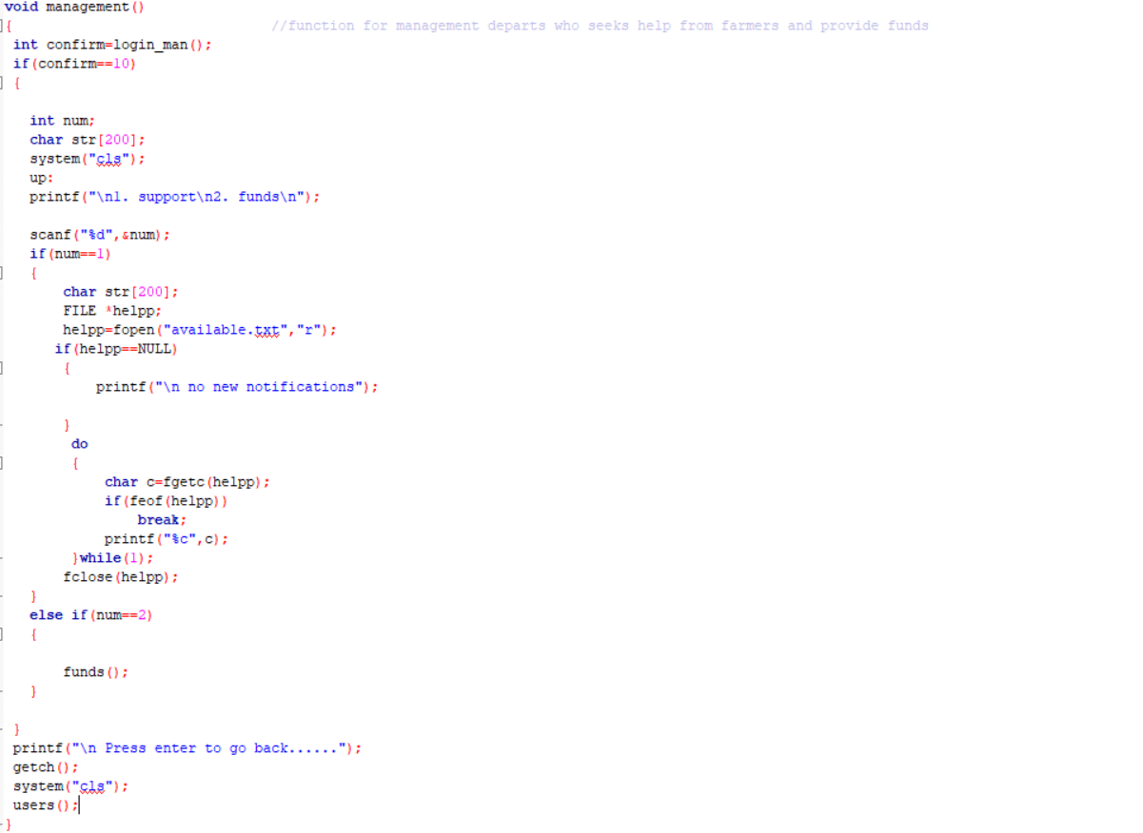
IMPLEMENTATION DETAILS OF EACH MODULE
Function for management

Slide 16
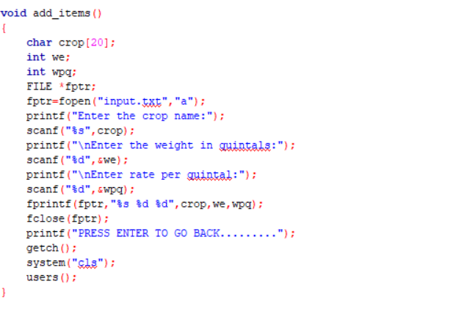
IMPLEMENTATION DETAILS OF EACH MODULE
Function for adding items:

Slide 17
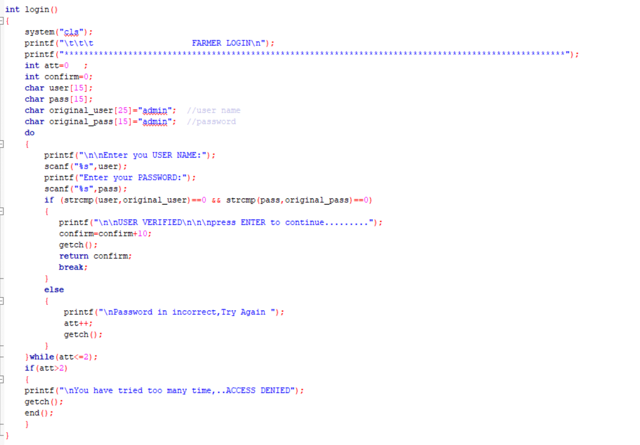
IMPLEMENTATION DETAILS OF EACH MODULE
Function for secured farmer login

Slide 18
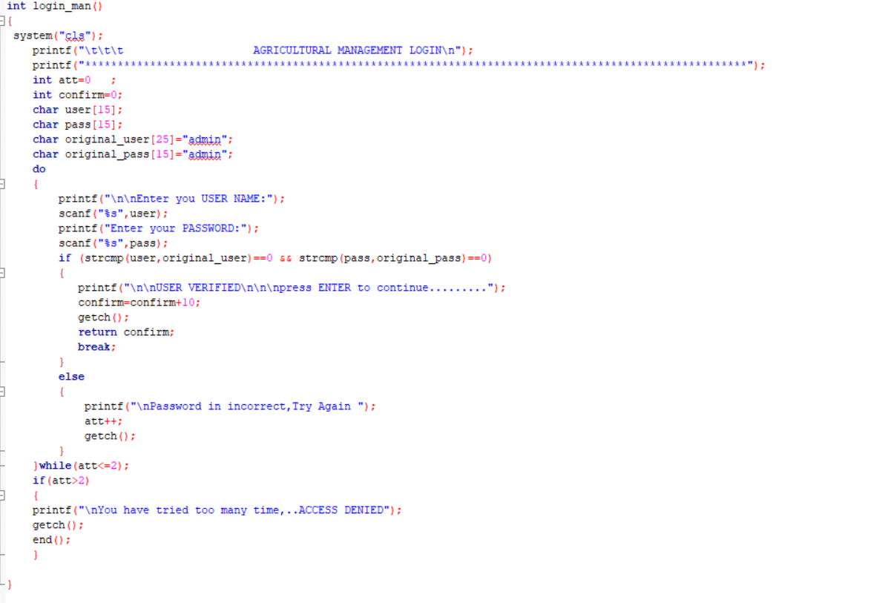
IMPLEMENTATION DETAILS OF EACH MODULE
Function for secured management login

Slide 19
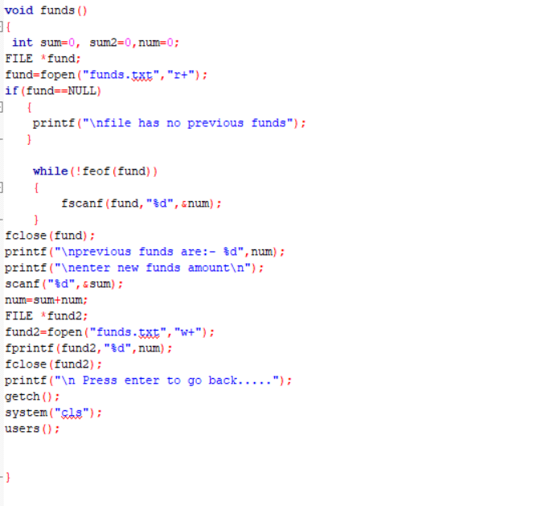
IMPLEMENTATION DETAILS OF EACH MODULE
Function for funds panel

Slide 20
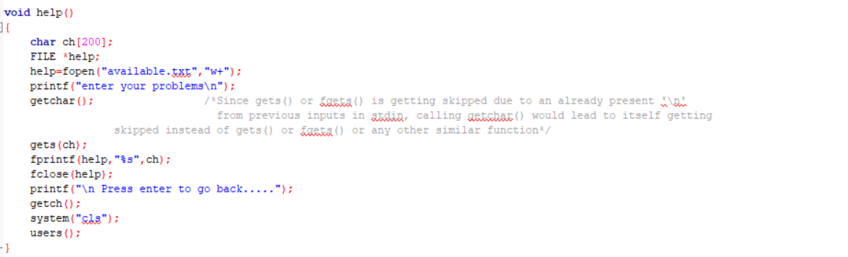
IMPLEMENTATION DETAILS OF EACH MODULE
Function for help

Slide 21
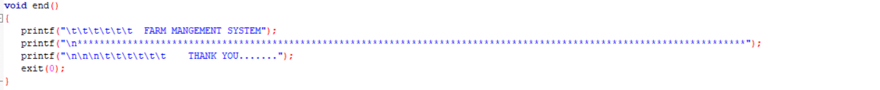
IMPLEMENTATION DETAILS OF EACH MODULE
End function:

Slide 22
IMPLEMENTATION DETAILS OF EACH MODULE
Main function:
To reduce the complexity the main function has less code.

Slide 23
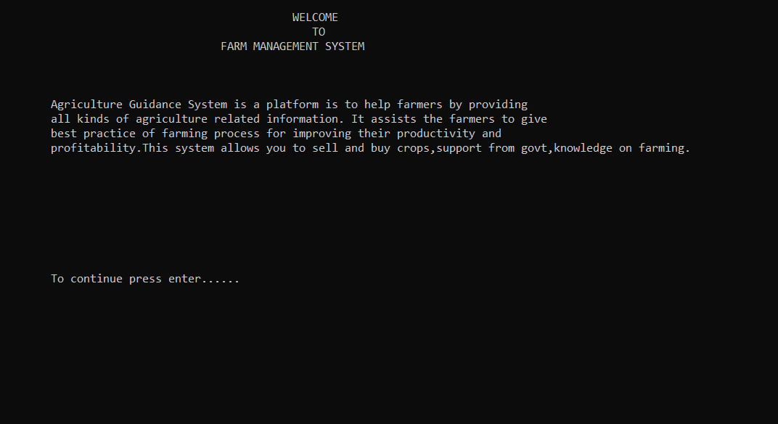
OUTPUTS: INTRO

Slide 24
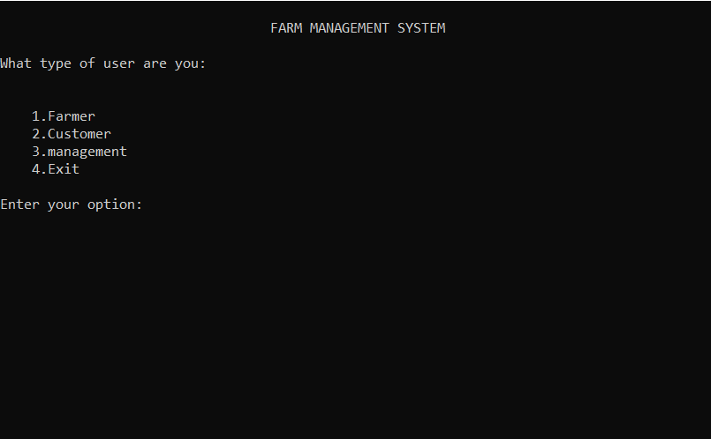
OUTPUTS: USER

Slide 25
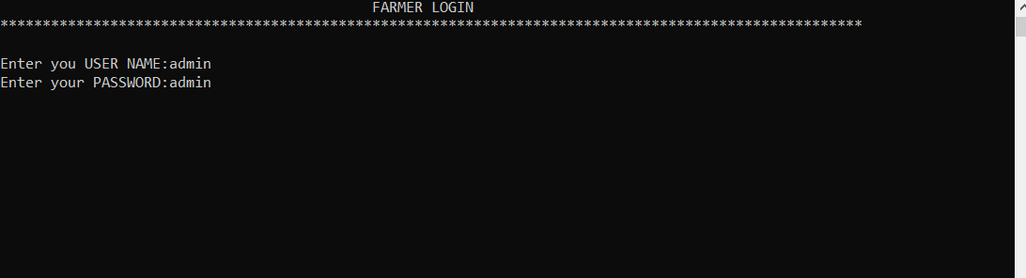
OUTPUTS: FARMER
Login:

Slide 26
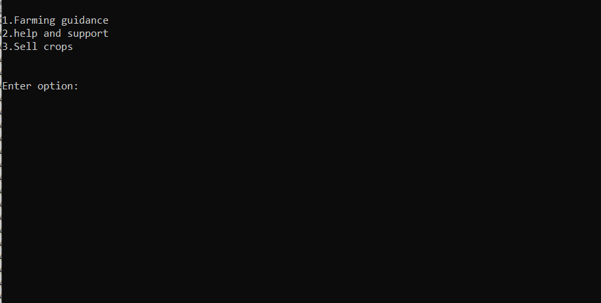
OPTIONS:

Slide 27
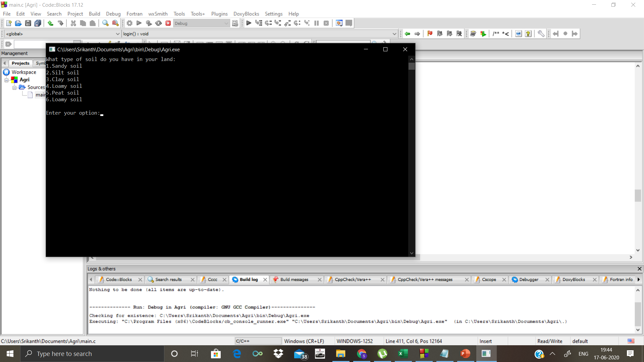
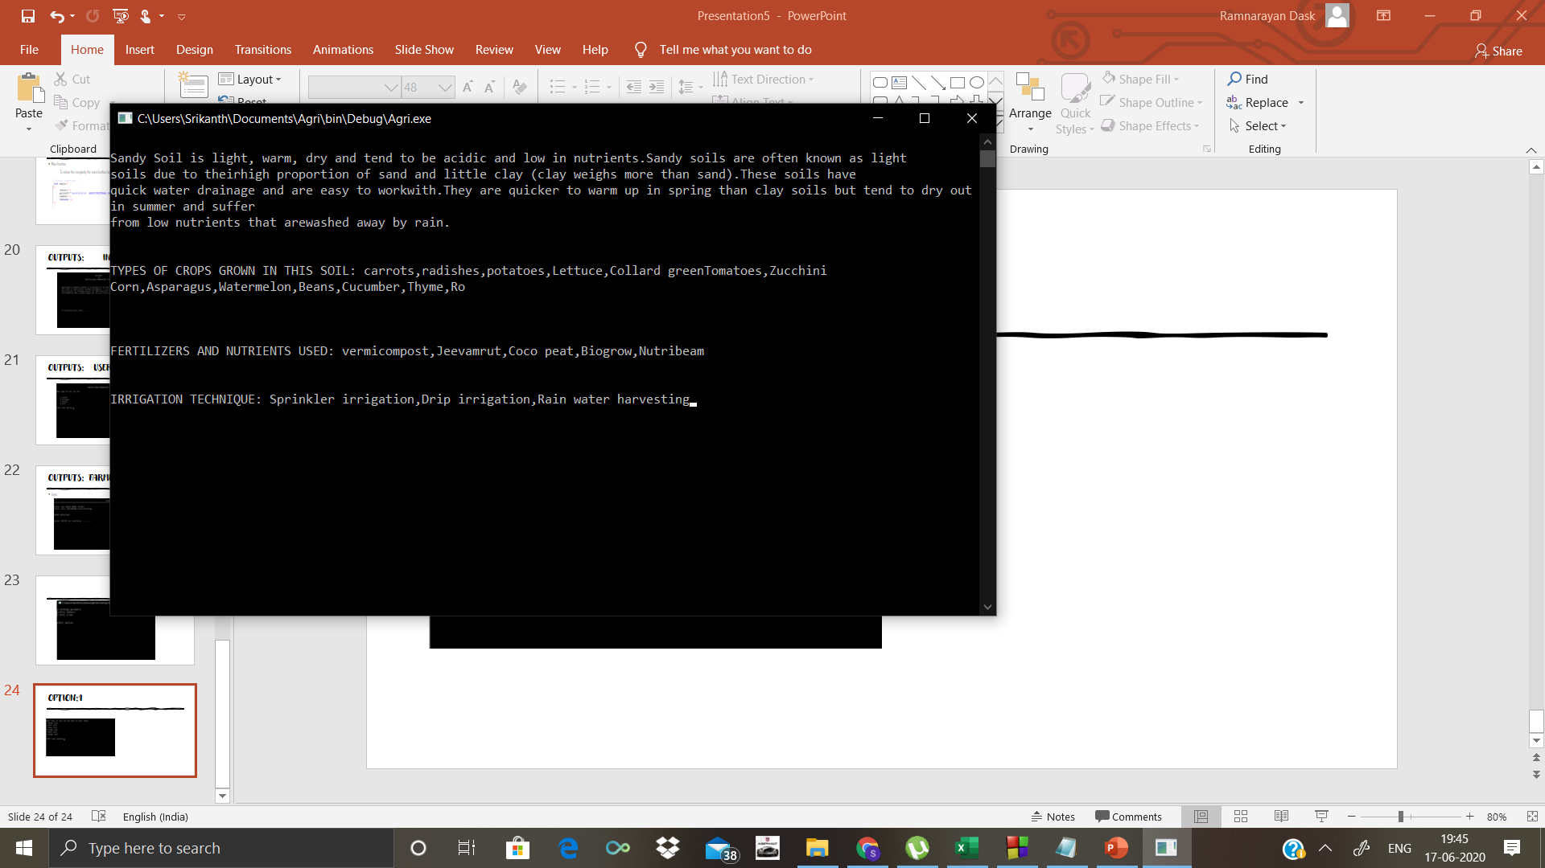
OPTION:1

Slide 28
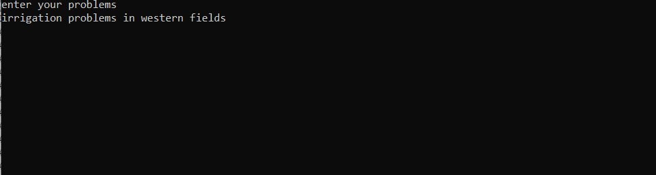
OPTION:2

Slide 29
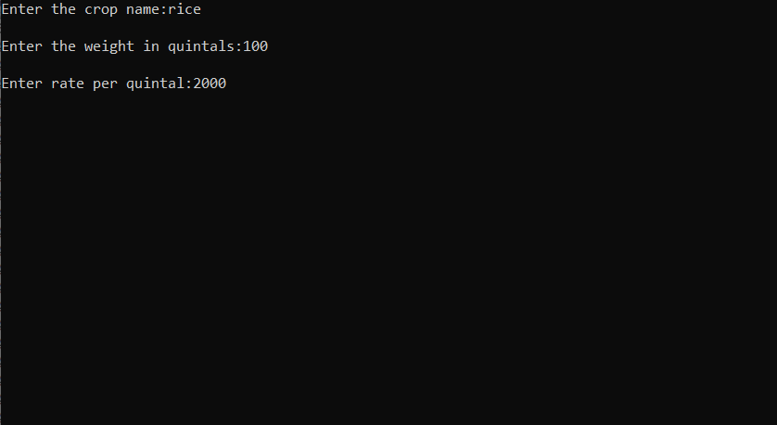
OPTION:3

Slide 30
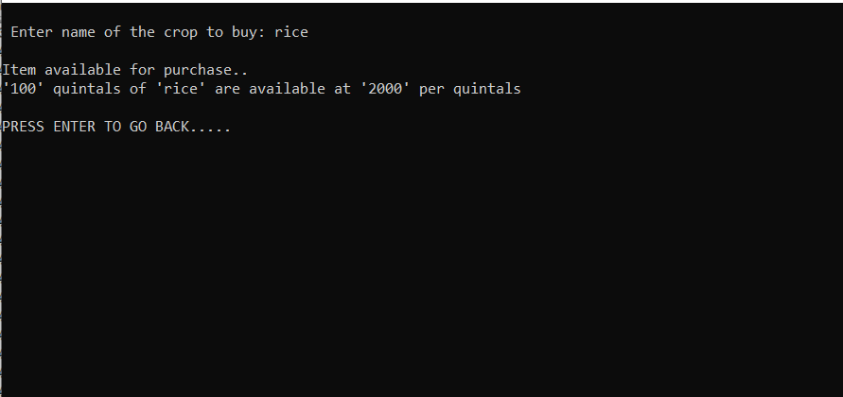
OUTPUTS: 2.CUSTOMER

Slide 31
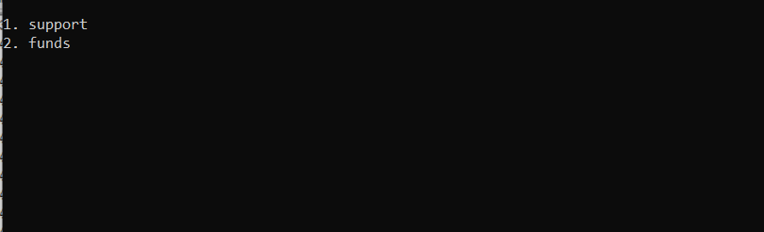
OUPUTS: 3.MANAGEMENT

Slide 32
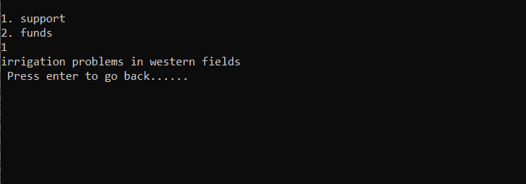
OPTION:1

Slide 33
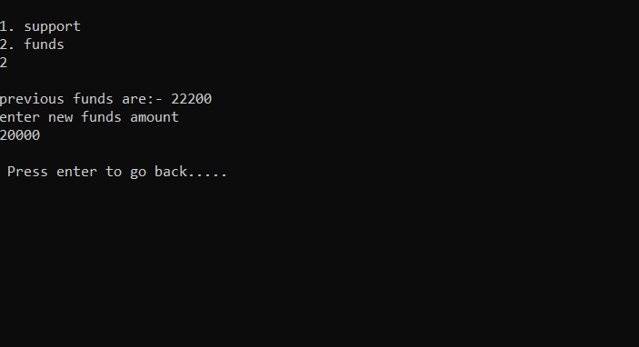
OPTION:2

Slide 34
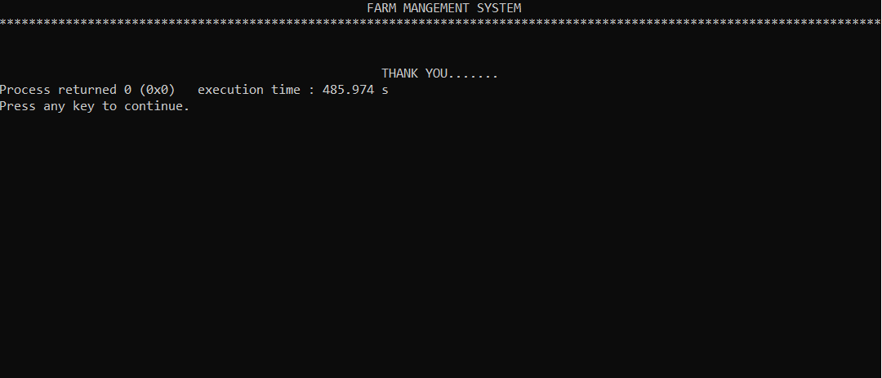
OUTPUTS: 4.EXIT

Slide 35
CONCLUSION:
This project thus pave the way for an efficient means to carryout the buying and selling of the products. Farmers will earn money as per as the work they have done and will not suffer loss. Also the advantage of this project is that it uses information technology.

Slide 36

This Photo by Unknown Author is licensed under CC BY-NC

Slide 37

CREDITS GOES TO:
1.VARUN BHARDWAJ
2.CHIRAG GUPTA
3.DARWIN DEBBARMA
4.GONDI RAJEEV
5.VENGALLA AKHIL

